Slide 1
Bluetooth Networks : A comprehensive study
- by Yash Kumar , Rashi Kumari

Slide 2
Introduction
Bluetooth is a wireless LAN technology designed to connect devices of different functions
A Bluetooth LAN is an ad hoc network
the devices, sometimes called gadgets, find each other and make a network called a piconet
A Bluetooth LAN can even be connected to the Internet
A Bluetooth LAN, by nature, cannot be large
Bluetooth technology is the implementation of a protocol defined by the IEEE 802.15 standard

Slide 3
Architecture
Piconet
Scatternet

Slide 4
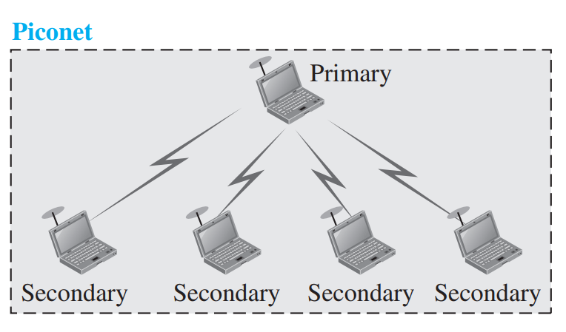
Piconet
A Bluetooth network is called a piconet, or a small net.
A piconet can have up to eight stations.
Piconet has - one primary , and rest secondaries
All the secondary stations synchronize their clocks and hopping sequence with the primary.
The communication between the primary and secondary stations can be one-to-one or one-to-many.
A piconet can have a maximum of seven secondaries, additional secondaries can be in the parked state.
A secondary in a parked state is synchronized with the primary, but cannot take part in communication until it is moved from the parked state to the active state.

Slide 5
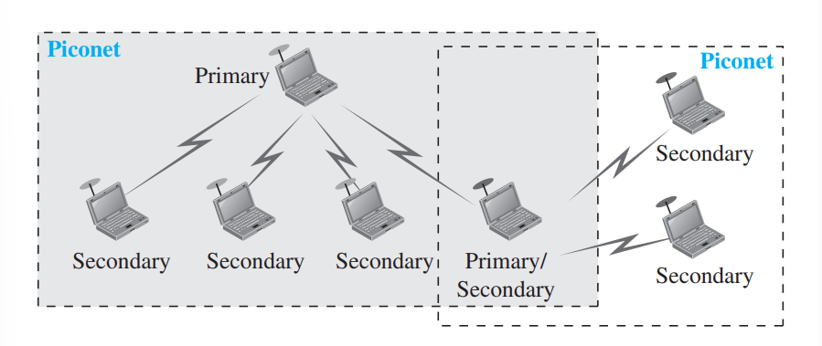
Scatternet
Scatternet
Piconets can be combined to form what is called a scatternet.
A secondary station in one piconet can be the primary in another piconet.
This station can receive messages from the primary in the first piconet (as a secondary) and, acting as a primary, deliver them to secondaries in the second piconet.
A station can be a member of two piconets.

Slide 6
Bluetooth Devices
A Bluetooth device has a built-in short-range radio transmitter.
The current data rate is 1 Mbps with a 2.4-GHz bandwidth.

Slide 7
Bluetooth Layers
L2CAP : Logical Link Control and Adaptation Protocol
Baseband Layer
Radio Layer

Slide 8
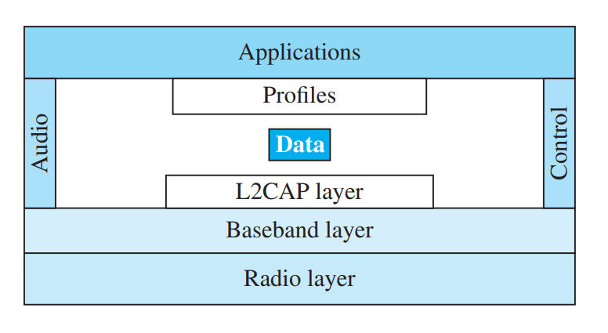
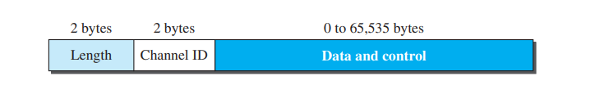
L2CAP
It is used for data exchange on an ACL link; SCO channels do not use L2CAP.
L2CAP data packet format
The 16-bit length field defines the size of the data, in bytes, coming from the upper layers. Data can be up to 65,535 bytes.
The channel ID (CID) defines a unique identifier for the virtual channel created at this level
The L2CAP has specific duties: multiplexing, segmentation and reassembly, quality of service (QoS), and group management.

Slide 9
->Multiplexing
The L2CAP can do multiplexing.
At the sender site, it accepts data from one of the upper-layer protocols, frames them, and delivers them to the baseband layer.
At the receiver site, it accepts a frame from the baseband layer, extracts the data, and delivers them to the appropriate protocol layer.
It creates a kind of virtual channel.

Slide 10
-> Segmentation and Reassembly
The maximum size of the payload field in the baseband layer is 2774 bits, or 343 bytes.
This includes 4 bytes to define the packet and packet length.
the size of the packet that can arrive from an upper layer can only be 339 bytes.
However, application layers sometimes need to send a data packet that can be up to 65,535 bytes (an Internet packet, for example).The L2CAP divides these large packets into segments and adds extra information to define the location of the segments in the original packet.
The L2CAP segments the packets at the source and reassembles them at the destination.

Slide 11
-> QoS
Bluetooth allows the stations to define a quality-of-service level.
if no quality-of-service, level is defined, Bluetooth defaults to what is called best-effort service.

Slide 12
-> Group Management
L2CAP allows devices to create a type of logical addressing between themselves.
This is similar to multicasting.
For example, two or three secondary devices can be part of a multicast group to receive data from the primary.

Slide 13
Baseband Layer
The baseband layer is roughly equivalent to the MAC sublayer in LANs.
The access method is TDMA
The primary and secondary stations communicate with each other using time slots.
The length of a time slot is exactly the same as the dwell time, 625 μs.
the communication is only between the primary and a secondary; secondaries cannot communicate directly with one another.

Slide 14
-> TDMA
Bluetooth uses a form of TDMA that is called TDD-TDMA (time-division duplex TDMA).
TDD-TDMA is a kind of half-duplex communication.
the communication for each direction uses different hops, similar to walkie talkies using different carrier frequencies.
-Single Secondary Communication
-Multiple Secondary Communication

Slide 15
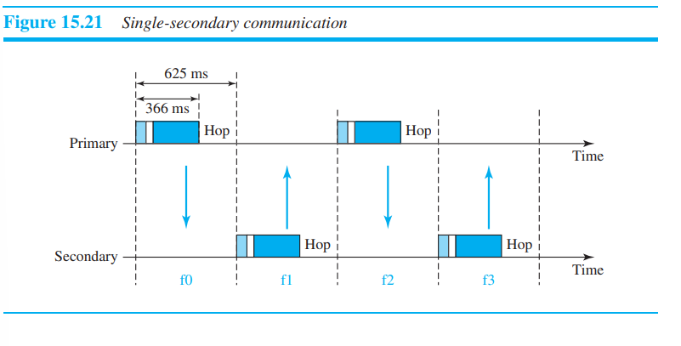
// Single-Secondary Communication

Slide 16
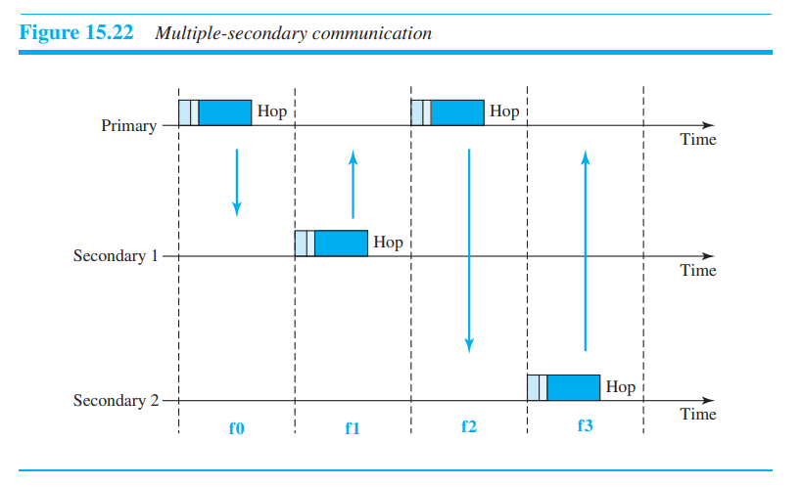
// Multiple-Secondary Communication

Slide 17
-> Links
Two types of links can be created between a primary and secondary link. 1. SCO - Synchronous connection-oriented link 2. ACL - Asynchronous connectionless link

Slide 18
// SCO
SCO is used when avoiding latency (delay in data delivery) is more important than integrity (error-free delivery).
a physical link is created between the primary and a secondary by reserving specific slots at regular intervals.
The basic unit of connection is two slots, one for each direction.
If a packet is damaged, it is never retransmitted.
SCO is used for real-time audio where avoiding delay is all-important.
A secondary can create up to three SCO links with the primary, sending digitized audio (PCM) at 64 kbps in each link.

Slide 19
// ACL
ACL is used when data integrity is more important than avoiding latency.
if a payload encapsulated in the frame is corrupted, it is retransmitted.
A secondary returns an ACL frame in the available odd-numbered slot if the previous slot has been addressed to it.
ACL can use one, three, or more slots and can achieve a maximum data rate of 721 kbps.

Slide 20
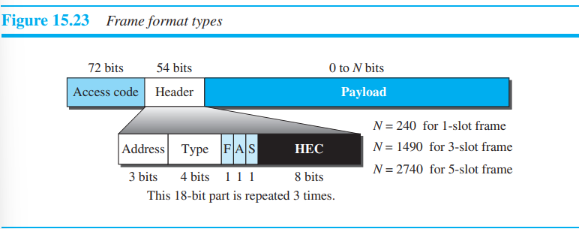
-> Frame Format
A frame can be - one slot, three slot, or five slot.
A slot is 625 μs
259 μs is needed for hopping and control mechanisms.
Access code: This 72-bit field normally contains synchronization bits and the identifier of the primary to distinguish the frame of one piconet from that of another.
Header: This 54-bit field is a repeated 18-bit pattern. Each pattern has the following subfields: 1. Address. The 3-bit address subfield can define up to seven secondaries (1 to 7). If the address is zero, it is used for broadcast communication from the primary to all secondaries. 2. Type. The 4-bit type subfield defines the type of data coming from the upper layers.

Slide 21
-> Frame Format (Contd)
3. F. This 1-bit subfield is for flow control. When set (1), it indicates that the device is unable to receive more frames (buffer is full). 4. A. This 1-bit subfield is for acknowledgment. Bluetooth uses Stop-and-Wait ARQ; 1 bit is sufficient for acknowledgment. 5. S. This 1-bit subfield holds a sequence number. Bluetooth uses Stop-and-Wait ARQ; 1 bit is sufficient for sequence numbering. 6. HEC. The 8-bit header error correction subfield is a checksum to detect errors in each 18-bit header section. The header has three identical 18-bit sections. The receiver compares these three sections, bit by bit. If each of the corresponding bits is the same, the bit is accepted; if not, the majority opinion rules. This is a form of forward error correction (for the header only). This double error control is needed because the nature of the communication, via air, is very noisy. Note that there is no retransmission in this sublayer.
Payload :This subfield can be 0 to 2740 bits long. It contains data or control information coming from the upper layers.

Slide 22
Radio Layer
The radio layer is roughly equivalent to the physical layer of the Internet model.
Bluetooth devices are low-power and have a range of 10 m.

Slide 23
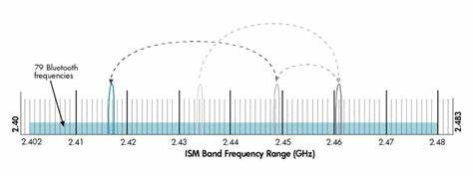
-> Band
Bluetooth uses a 2.4-GHz ISM band divided into 79 channels of 1 MHz each.

Slide 24
->FHSS
frequency-hopping spread spectrum (FHSS).
Bluetooth hops 1600 times per second.
A device uses a frequency for only 625 μs (1/1600 s) before it hops to another frequency; the dwell time is 625 μs.

Slide 25
-> Modulation
Bluetooth uses a sophisticated version of FSK, called GFSK.
Bit 1 is represented by a frequency deviation above the carrier; bit 0 is represented by a frequency deviation below the carrier.
The frequencies, in megahertz, are defined as:

Slide 26
Reference
Data communication and Networking - Behrouz A Forouzan - Mcgraw Hill - Fifth Edition ( Section 3 , Chapter 15 )

